Slide 1
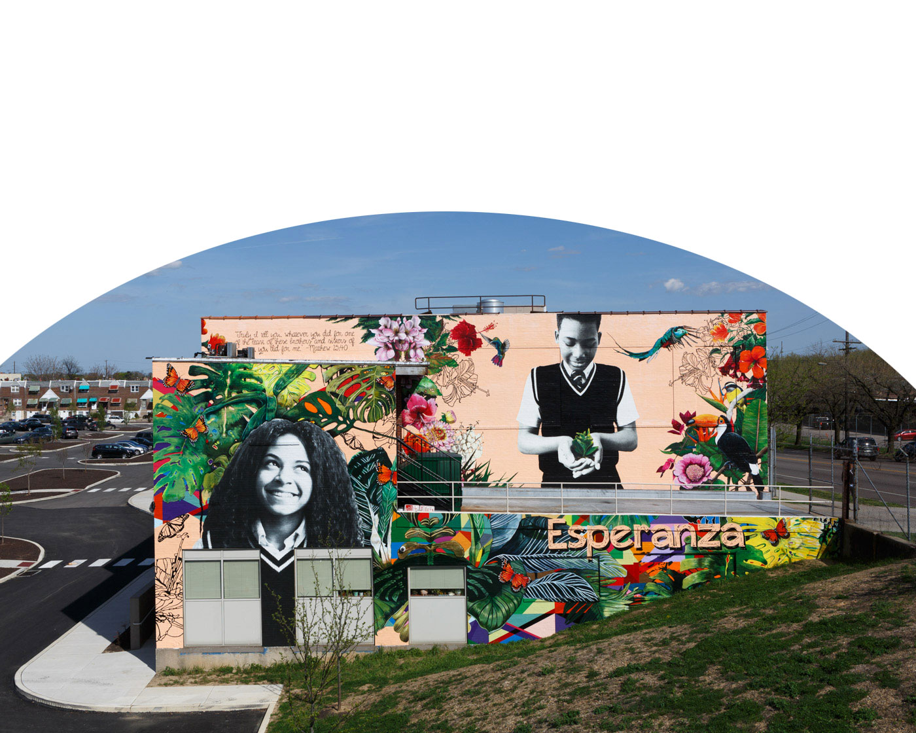

Esperanza | Human Resources
WELCOME TO ESPERANZA!
Presentations are communication tools that can be used as lectures.

Slide 2
ADDITIONAL RECOMMENDATIONS
ONE-ON-ONE MEETING
TEAM BUILDING EXERCISES
FIRST
WEEK CHECKLIST
INTER
DEPART
MENTAL
Presentations are communication tools that can be used as lectures.
Presentations are communication tools that can be used as lectures.
Presentations are communication tools that can be used as lectures.
Presentations are communication tools that can be used as lectures.

Slide 3



FROM HIRING TO ONBOARDING
APPLICATION
INTERVIEW
ONBOARDING
Presentations are communication tools.
Presentations are communication tools.
Presentations are communication tools.

Slide 4
THE IDEAL EMPLOYEE
WORK ETHIC
Presentations are communication tools that can be used as lectures.
PERSONALITY
Presentations are communication tools that can be used as lectures.
GROWTH
Presentations are communication tools that can be used as lectures.
Esperanza | Human Resources

Slide 5



WHY NEW HIRES LOVE ESPERANZA
Presentations are communication tools that can be used as lectures.

Slide 6



Academic and dynamic
Jaffra Hayes
Simon Uzneka
Jessika Burghes
Head of Admissions
Head of Student Relations
Head of Student Services

Slide 7
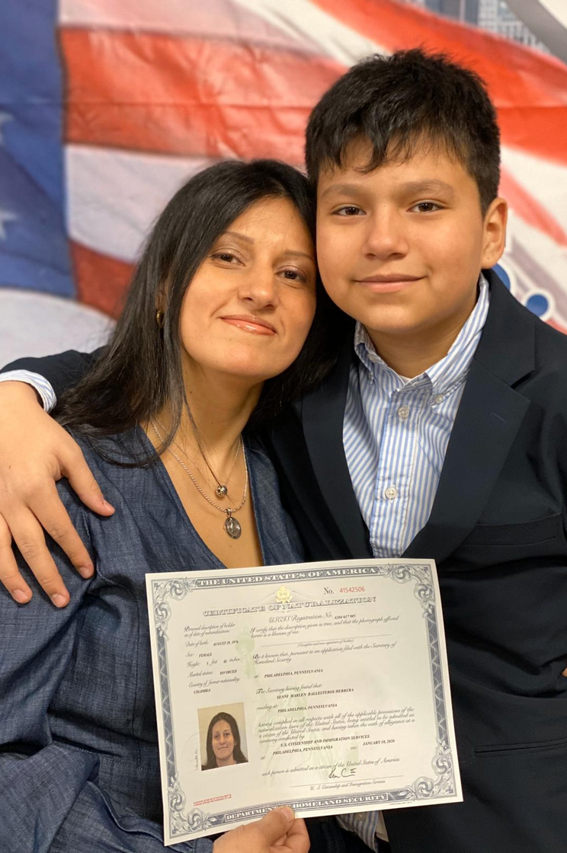
CLIENT DEMOGRAPHICS
What we know about
our target market
Presentations are communication tools that can be used as demonstrations, lectures, speeches, reports, and more.

